Slide 1
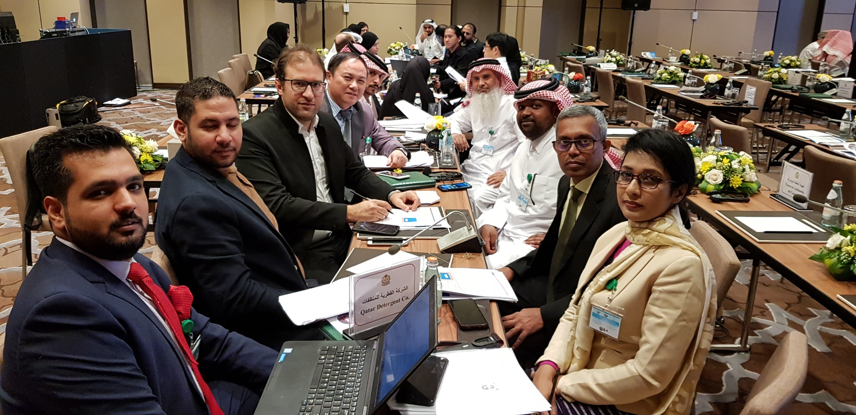
Group-4

Slide 2
Workshop # 7
TA and PHA both are needed
The TA is needed because to maximize same amoutna dn quality of the output by understanding the difference of the two vessels
PHA has to be done to ensure the new vessel’s risks and hazards are being communicated and documented to perform the operation with the least amount of risks and should there be any control measures needed, they are taken into account.
Difference of the two vessels:
There is a dimension difference
A potential difference in the type of valves or nozzle orientation as well

Slide 3
Workshop # 8
Responding to the situation, there could be different ways this could be solved:
Option 1:
Is the process of introducing the new vessel system really reliable and passes all the tests? Maybe, we can ask the team available to run a feasibility study, while I finish the meeting off-site. Come back, and re-assess the situation and proceed with a decision.
Option 2:
Perhaps the safety meeting could be chaired for one day by someone else and / or can be rescheduled in order to proceed with the installation of the new vessel

Slide 4
Workshop # 9
To ensure there is an effective interlocking system, following are the areas we need to consider:
Technical specifications of the interlocking system before purchasing one:
What material is it made up of? Does it react to Toluene?
What is the efficiency level of this system? Does it give false alarms?
Does it operate on batteries or electricity? What if there is an electric shut down?
What are the maintenance and consumable requirements of this system?

Slide 5
Workshop # 9
Keep in mind that the interlocking system is installed to “assist” the manual operation – not to “remove” the manual operation. Therefore, having the interlocking system should “not” give an impression to the manual operator that his personal attention is no longer needed.
Does the interlocking system come with a special operating process? If yes, then the employees need to be trained on how and when to operate them.
TBC

Slide 6
Workshop # 9
Regular checks to ensure efficiency of the system is important. Since this is a new system installed with a current system, we would need:
The safety officer to run weekly inspection on the interlocking system at least for the first 3 months and report any findings, or any preventive maintenance needed.
The production engineer to ensure that even with the new system in place, the production is not stopped.
If everything is running perfectly fine, the routine inspection can be done on a monthly basis, after the completion of 3 months.

